Slide 1

Project RISE Leadership Academy
WS# 74884
Karina E. Chapa, M.Ed.
Language Proficiency, Biliteracy and Cultural Diversity Director
kchapa@esc1.net
Twitter @esc1bilingual @bilingualpride

Slide 2

Professional Learning Essential Agreements
Be respectful of others
Be an active participant
Take care of your needs
Use electronic devices as learning tools

Slide 3

Keeping It Together
Leadership Academy:
ELL

Slide 4
Ell demographics
Educational Impact

Slide 5
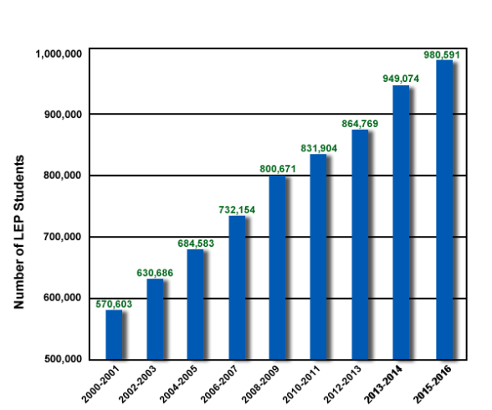
ELLs in Texas
160,000+
in Region One
Source: TEA, 2016

Slide 6
Changing Texas: 2050
Average Age
NHW 42
HW 28
Population
NHW 2%
HW 70%
Workforce
H vs NH
3:1
ECONOMIC
PRECIPICE
“In the absence of change, the Texas labor force as a whole will be less-educated, work in lower-status occupations, and have lower incomes in 2050 than 2010”
Steve Murdock, 2013

Slide 7
Changing Texas: 2050
Average Age
NHW 42
HW 28
Population
NHW 2%
HW 70%
Workforce
H vs NH
3:1
EDUCATION
FUTURE PROSPERITY
We are that CHANGE!

Slide 8
The Power of Region One
97% Hispanic
37% ELL PK-12
85% EcoDis
Region One TODAY
Texas in 30 Years

Slide 9
Tiered Professional Learning
Content
Teacher
Leader
System

Slide 10
The Role of the Leader
Successful ELL Program
Leadership Support
Quality Instructional Materials
Teacher Preparation
Carrasquillo and Rodriguez (1998) Measuring Success in Bilingual Education Programs: Case Studies of Exemplary Practices

Slide 11
The Role of the Leader
Low levels of ELL understanding
ELL Program Success
ELL Program Success
High levels of ELL understanding
Menkena and Solorzaba (2014) Principals as Linchpins in Bilingual Education: The Need for Prepared School Leaders.

Slide 12
Keeping It Together
Leadership Academy:
ELL
ELL Demographics

Slide 13

Second Language Acquisition
Notes:
45 mins

Slide 14
Session Objectives
Content Objective
Language Objective
Today I will analyze the second language acquisition process and understand its impact in the education of English Language Learners.
Today I will discuss with my peers the second language acquisition process and I will share orally and in writing my individual language profile.

Slide 15

SLA Anticipation Guide
Let’s
kahoot.it

Slide 16
Language Power
Cognitive
Social
Affective
“Language stands at the center of the many interdependent cognitive, affective, and social factors that shape learning”.
David Corson, 1999
LANGUAGE
=
IDENTITY
3-Step Interview

Slide 17
The Iceberg Theory
Basic Interpersonal Communication Skills
BICS
1-3 years
CALP
5-7 years
Cognitive Academic Language Proficiency
J. Cummins, 1981

Slide 18
Double Iceberg Theory
BICS L1 1-3 years
BICS L2 1-3 years
CALP L1+L2
5-7 years
J. Cummins, 1981

Slide 19
Transfer of Concepts
L1
L2
CALP
L1
L2
J. Cummins, 1981

Slide 20
In Other Words…
BICS L1
BICS L2
CALP
L1
L2
CALP Transfer L1-L2
J. Cummins, 1981

Slide 21
Research Findings
The stronger academically and cognitively the L1, the stronger the L2.
The weaker academically and cognitively the L1, the weaker the L2.
W. Thomas & V. Collier, 2009
Turn and Talk
Think-Pair-Share

Slide 22
My Language Profile
BICS Spanish
BICS English
CALP Spanish + English
1999

Slide 23
My Language Profile
BICS Spanish
BICS English
CALP Spanish + English
2017

Slide 24
Your Turn!
BICS L1
BICS L2
CALP L1+L2
Create your own language profile
Birthday Line
Notes:
90 mins

Slide 25
Bilingual Program Models
Chapter 89, Jigsaw/Frayer Model
Bilingual Education
Remedial ( - )
Immersion
Early Exit
Enrichment (+)
Late Exit
Dual Language
One-Way
Two-Way

Slide 26
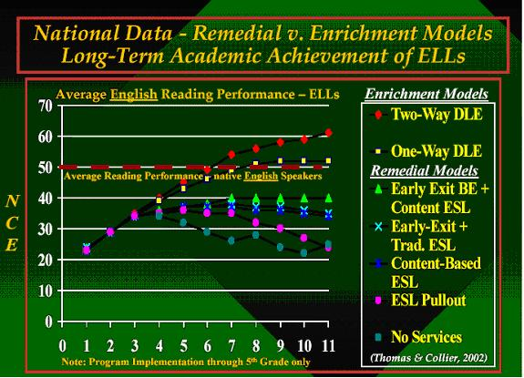
W. Thomas and V. Collier, 2002

Slide 27
Keeping It Together
Leadership Academy:
ELL
ELL Demographics
Second Language Acquisition

Slide 28
TELPAS-ELPS Connection

Slide 29
TEKS vs ELPS
STAAR
TELPAS
T
E
K
S
E
L
P
S

Slide 30
TEKS vs ELPS
Academic Proficiency Language Proficiency
STAAR
TELPAS
TEKS
ELPS
Relating Factor: evaluates/measures

Slide 31
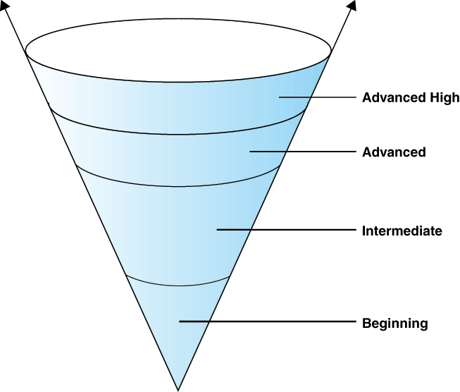
TELPAS Levels

Slide 32
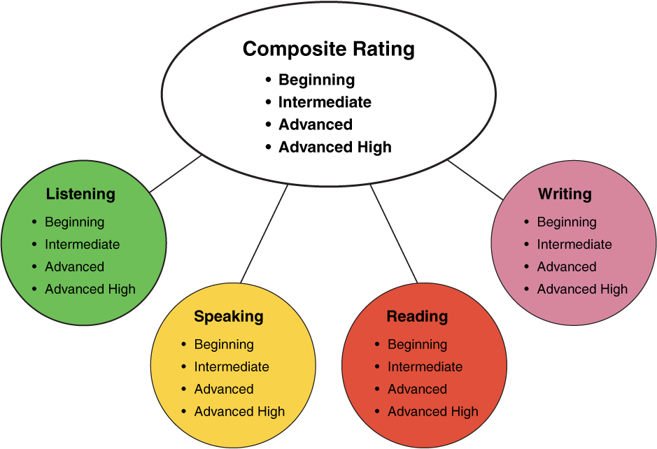
TELPAS Domains
10%
30%
10%
50%
Online for 2nd-12th

Slide 33
DMAC TELPAS Reports
How to Run TELPAS Reports by Language Domain
Go to Home Page
Go to State Assessment
Select TELPAS
Select Instructional Reports
Select Student Language Proficiency Rating
Generate Report

Slide 34
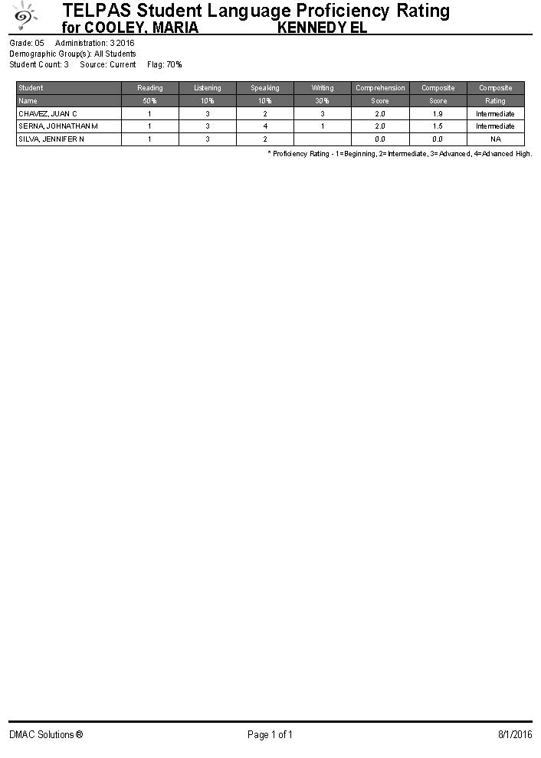
Sample DMAC Report

Slide 35


ELPS Resources
LIAG and ELPS Instructional Tool
+
DMAC Reports

Slide 36
Keeping It Together
Leadership Academy:
ELL
ELL Demographics
Second Language Acquisition
TELPAS-ELPS Connection

Slide 37
STATE ACCOUNTABILITY
HB22: A-F System

Slide 38
Session Objectives
Content Objective
Today I will analyze different accountability systems and the impact they have on the instruction of English Language Learners.
Language Objective
Today I will discuss how different accountability systems impact my school and my district.

Slide 39



A–F Accountability: Legislative Context
HB
2804
HB
22
House Bill 22, 85th Texas Legislature
The commissioner shall evaluate school district and campus performance and assign each district and campus an overall performance rating of
A B C D or F
Notes:
House Bill 22, just like HB 2804 (its predecessor) requires the commissioner to evaluation district and campus performance and assign grades of A, B, C, D, or F.

Slide 40
A–F Accountability:
New Labels/Grades
A = Exemplary Performance
B = Recognized Performance
C = Acceptable Performance
D = In Need of Improvement
F = Unacceptable Performance

Slide 41


A–F Accountability:
Stakeholder Input
House Bill 22, 85th Texas Legislature
“The commissioner shall solicit input statewide from persons . . . , including school district boards of trustees, administrators and teachers employed by school districts, parents of students enrolled in school districts, and other interested stakeholders.”
Feedback Opportunities
Will solicit input on the aspects over which commissioner has authority
Won’t solicit input on aspects that are required by statute
Administrators
Teachers
Parents
Trustees
Notes:
HB 22 mentions getting feedback from stakeholder or committees three separate times.

Slide 42


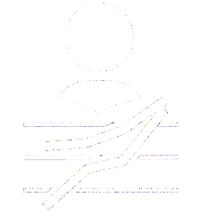
Three Domains:
Combining to Calculate Overall Score
Best of Achievement or Progress
Minimum 30%
Feedback Opportunities
Certain methodology decisions in each domain
Cut points for each grade in each domain
Weight (30% or more) to Closing the Gaps Domain
Student Achievement
School
Progress
Closing
The Gaps
Notes:
To calculate the overall grade, TEA will use the best of the Student Achievement domain or School Progress domain and combine it with the grade of the Closing the Gaps domain, which must account for at least 30% of the overall grade.
This can only be applied to districts or campuses that do not have an F in either the student achievement or school progress domain. If a district or campus receives an F in either of those two domains, TEA will use a grade of no greater than B for that portion of the overall grade.

Slide 43
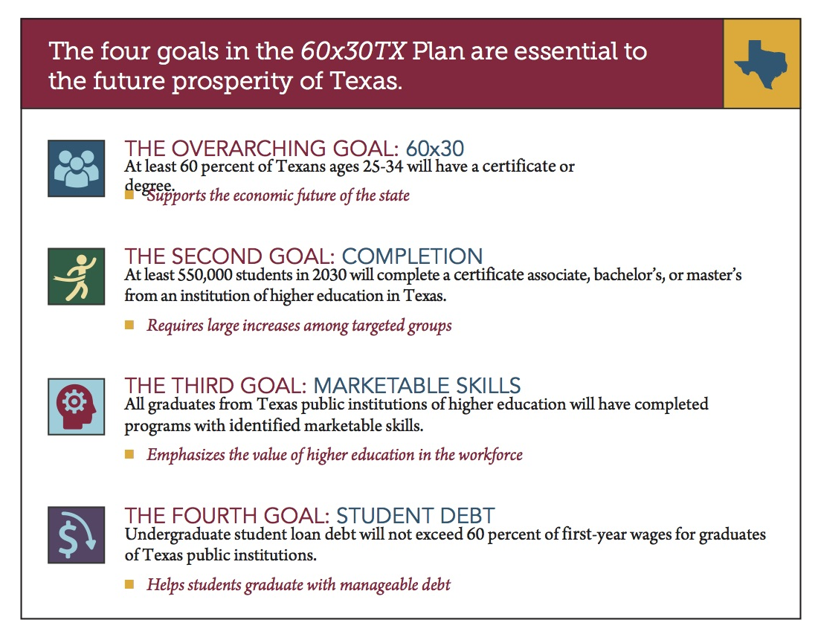

Texas Higher Education Strategic Plan: 2015-2030
Expert Gallery Walk
WS# 74884

Slide 44
Keeping It Together
Leadership Academy:
ELL
ELL Demographics
Second Language Acquisition
TELPAS-ELPS Connection
State Accountability

Slide 45
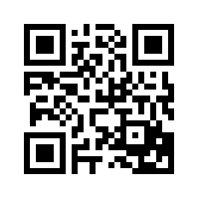
Exit Tickets
Go to:
https://tinyurl.com/ELLRISE
I used to think…
But now I know…

Slide 46
Thank you for your participation!
Karina E. Chapa, M.Ed.
Language Proficiency, Biliteracy and Cultural Diversity Director
kchapa@esc1.net
Facebook: Region One ESC Bilingual
Twitter @esc1bilingual @bilingualpride

